Slide 1
Time-step-free Physics-Based Modeling of Retention Loss in Cryogenic 3-D NAND Flash Myung Jin

Slide 2
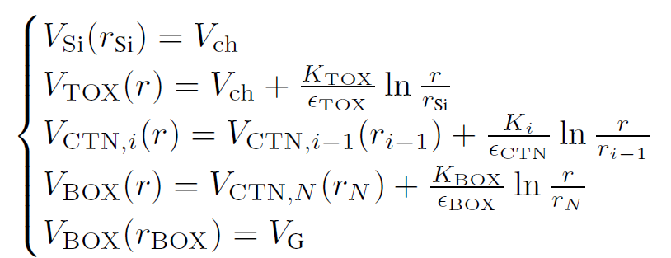
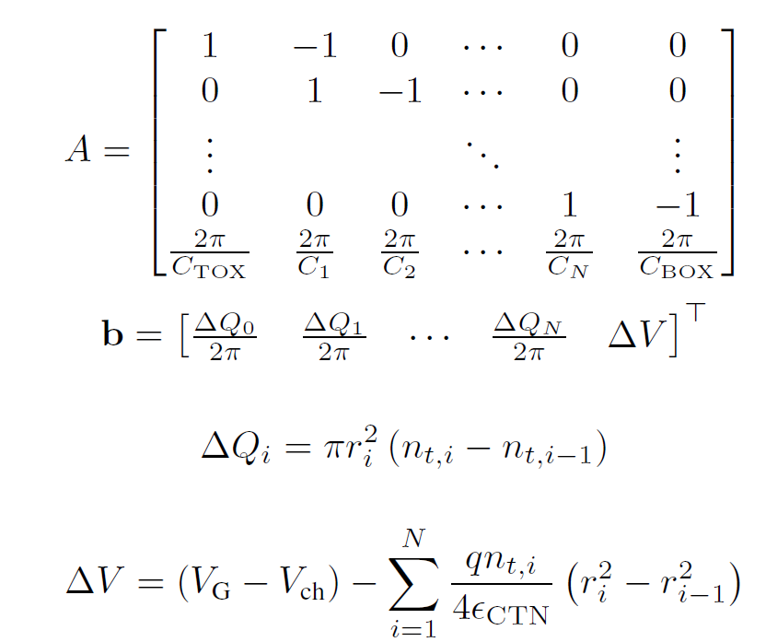


Detailed Poisson Solution
Potential Solution: Poisson equation
Boundary conditions
Solution

Slide 3


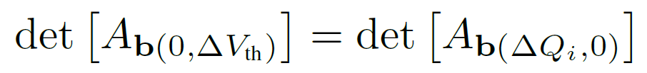
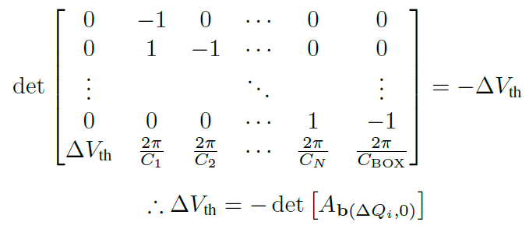
Q-ΔV_{th} Relation
ΔV_{th} : Equivalent channel field intensity
By Cramer’s rule,

Slide 4
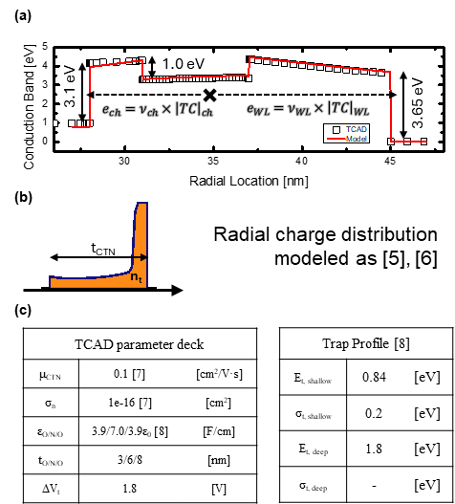
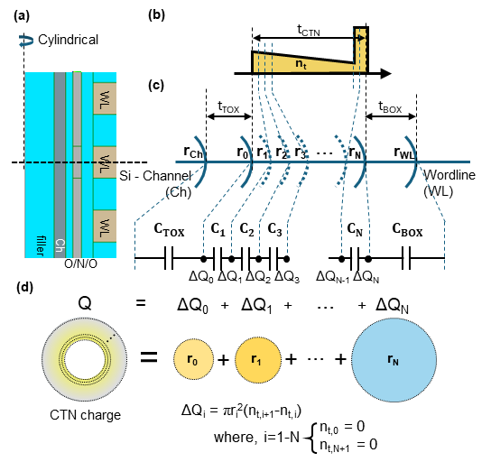
Visualization & Parameters

Slide 5
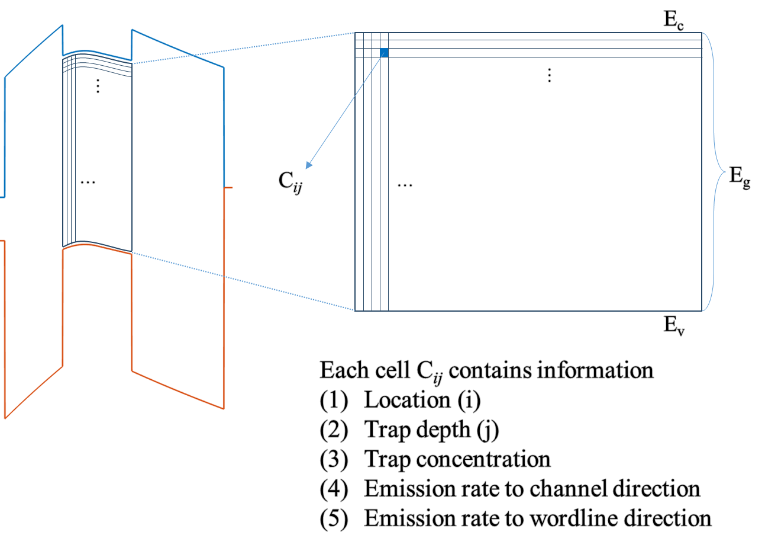
Time-step-free Physics-based Modeling
Main Idea: simulation done with initial condition
=> different from time stepping transient simulation
1. Initial state
n_{t0}(r, E_{t})
2. Emission rates
e_{ch}, e_{WL}
3. Direct evaluation
n_{t}(r, E_{t}, t)
계산 비용은 final retention time 자체가 아니라
trap bin 수와 evaluated time point 수에 의해 결정

Slide 6
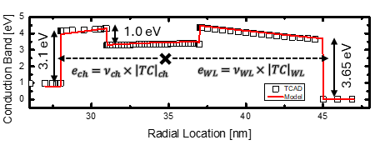
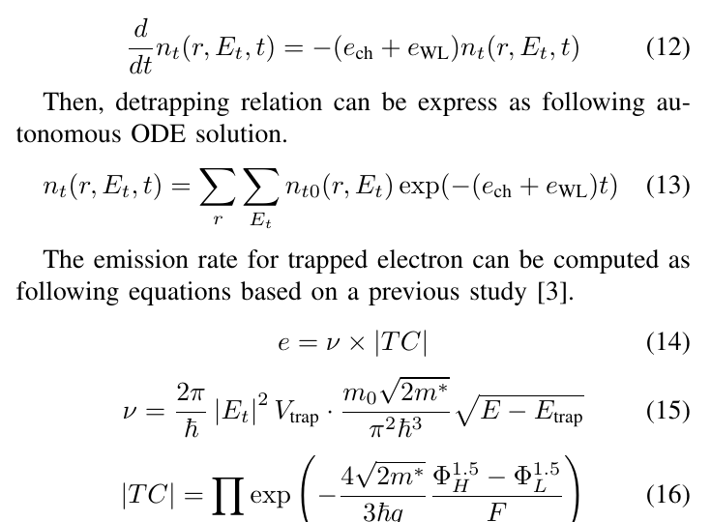
Time-step-free Physics-based Modeling
Main Idea: simulation done with initial condition
=> different from time stepping transient simulation
1. Initial state
n_{t0}(r, E_{t})
2. Emission rates
e_{ch}, e_{WL}
3. Direct evaluation
n_{t}(r, E_{t}, t)

Slide 7

Time-step-free Physics-based Modeling
Main Idea: simulation done with initial condition
=> different from time stepping transient simulation
1. Initial state
n_{t0}(r, E_{t})
: Autonomous ODE
Detrapping Autonomous ODE
2. Emission rates
e_{ch}, e_{WL}
3. Direct evaluation
n_{t}(r, E_{t}, t)
Initial state
closed-form evaluation
computation resource는 final retention time 자체가 아니라
trap bin 수와 evaluated time point 수에 의해 결정

Slide 8
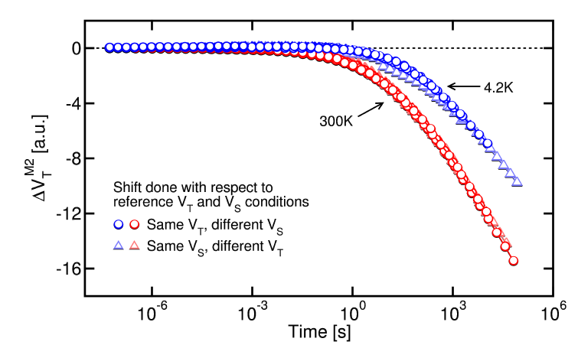
Cryogenic Calibration
Measurement (Refaldi, IRPS 2025)
Cryogenic condition (~ 4.2K) : physical separation of detrapping effect from vertical retention loss
Separation of detrapping effect measurement

Slide 9
Cryogenic Calibration
Measurement (Refaldi, IRPS 2025)
Measurement – TCAD calibration
model – TCAD match
t_{TOX}
= 3, 3.5, 4, 4.5, 5 [nm]
TCAD cryogenic: σ → 0 [cm²]
O/N/O = 3/6/8
t_{TOX} = 3 ~ 5 [nm]

Slide 10
Iteration Test

Slide 11
Computational Impact
Property
Transient TCAD
Time-step-free model
Temporal
treatment
Sequential
time stepping
Closed-form
evaluation of Eq. (13)
Final-time
dependence
Runtime grows as
simulated retention time increases
Independent of final
physical time for fixed queries
Average
runtime
27483 s
3.926 s
≈ 7000×
runtime reduction
TCAD 는 final physical time까지 time step 별 순차적으로 계산
Time-step-free model은 closed-form evaluation
Computational resource는 final retention time 자체가 아니라 trap bin 수와 evaluated time point 수에 의해 결정

